Slide 1

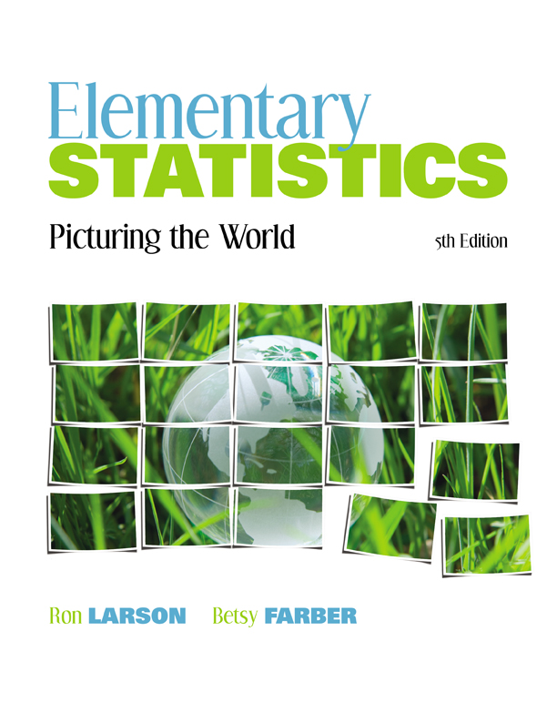

Chapter
3
Probability
© 2012 Pearson Education, Inc.
All rights reserved.
<number> of 88

Slide 2
Chapter Outline
3.4 Additional Topics in Probability and Counting
© 2012 Pearson Education, Inc. All rights reserved.
<number> of 88

Slide 3
Section 3.4
Additional Topics in Probability and Counting
© 2012 Pearson Education, Inc. All rights reserved.
<number> of 88

Slide 4
Section 3.4 Objectives
Determine the number of ways a group of objects can be arranged in order
Determine the number of ways to choose several objects from a group without regard to order
Use the counting principles to find probabilities
© 2012 Pearson Education, Inc. All rights reserved.
<number> of 88

Slide 5
Permutations
Permutation
An ordered arrangement of objects
The number of different permutations of n distinct objects is n! (n factorial)
  n! = n∙(n – 1)∙(n – 2)∙(n – 3)∙ ∙ ∙3∙2 ∙1
  0! = 1
  Examples:
    6! = 6∙5∙4∙3∙2∙1 = 720
    4! = 4∙3∙2∙1 = 24
© 2012 Pearson Education, Inc. All rights reserved.
<number> of 88

Slide 6
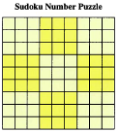
Example: Permutation of n Objects
The objective of a 9 x 9 Sudoku number puzzle is to fill the grid so that each row, each column, and each 3 x 3 grid contain the digits 1 to 9. How many different ways can the first row of a blank 9 x 9 Sudoku grid be filled?
Solution:
The number of permutations is
9!= 9∙8∙7∙6∙5∙4∙3∙2∙1 = 362,880 ways
© 2012 Pearson Education, Inc. All rights reserved.
<number> of 88

Slide 7
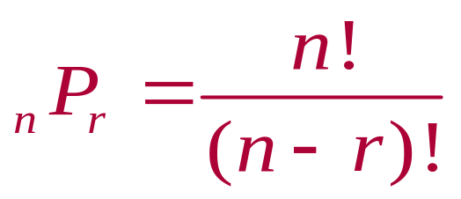
Permutations
Permutation of n objects taken r at a time
The number of different permutations of n distinct objects taken r at a time
■
where r ≤ n
© 2012 Pearson Education, Inc. All rights reserved.
<number> of 88

Slide 8

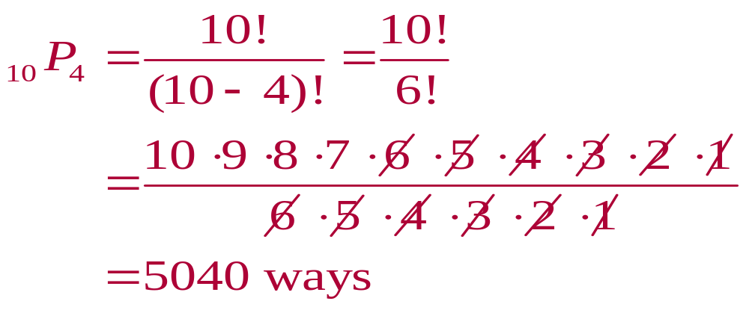
Example: Finding nPr
Find the number of ways of forming four-digit codes in which no digit is repeated.
Solution:
You need to select 4 digits from a group of 10
n = 10, r = 4
© 2012 Pearson Education, Inc. All rights reserved.
<number> of 88

Slide 9

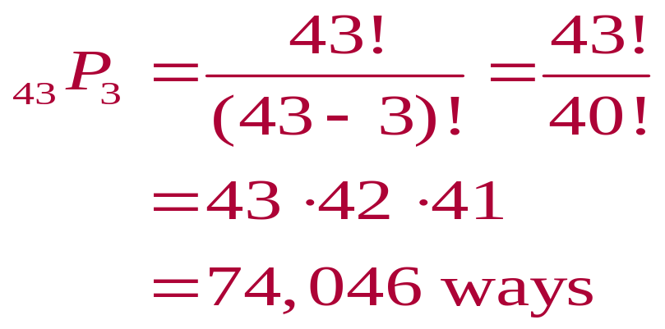
Example: Finding nPr
Forty-three race cars started the 2007 Daytona 500. How many ways can the cars finish first, second, and third?
Solution:
You need to select 3 cars from a group of 43
n = 43, r = 3
© 2012 Pearson Education, Inc. All rights reserved.
<number> of 88

Slide 10
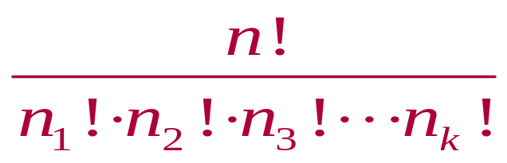
Distinguishable Permutations
Distinguishable Permutations
The number of distinguishable permutations of n objects where n₁ are of one type, n₂ are of another type, and so on
■
where n₁ + n₂ + n₃ +∙∙∙+ n_{k} = n
© 2012 Pearson Education, Inc. All rights reserved.
<number> of 88

Slide 11

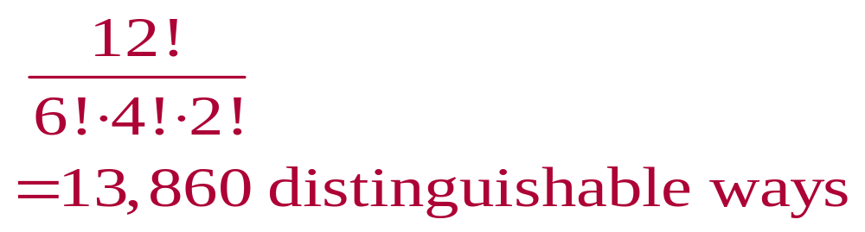
Example: Distinguishable Permutations
A building contractor is planning to develop a subdivision that consists of 6 one-story houses, 4 two-story houses, and 2 split-level houses. In how many distinguishable ways can the houses be arranged?
Solution:
There are 12 houses in the subdivision
n = 12, n₁ = 6, n₂ = 4, n₃ = 2
© 2012 Pearson Education, Inc. All rights reserved.
<number> of 88

Slide 12
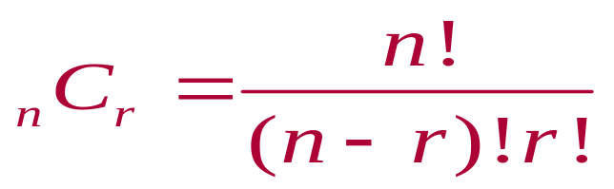
Combinations
Combination of n objects taken r at a time
A selection of r objects from a group of n objects without regard to order
■
© 2012 Pearson Education, Inc. All rights reserved.
<number> of 88

Slide 13

Example: Combinations
A state’s department of transportation plans to develop a new section of interstate highway and receives 16 bids for the project. The state plans to hire four of the bidding companies. How many different combinations of four companies can be selected from the 16 bidding companies?
Solution:
You need to select 4 companies from a group of 16
n = 16, r = 4
Order is not important
© 2012 Pearson Education, Inc. All rights reserved.
<number> of 88

Slide 14
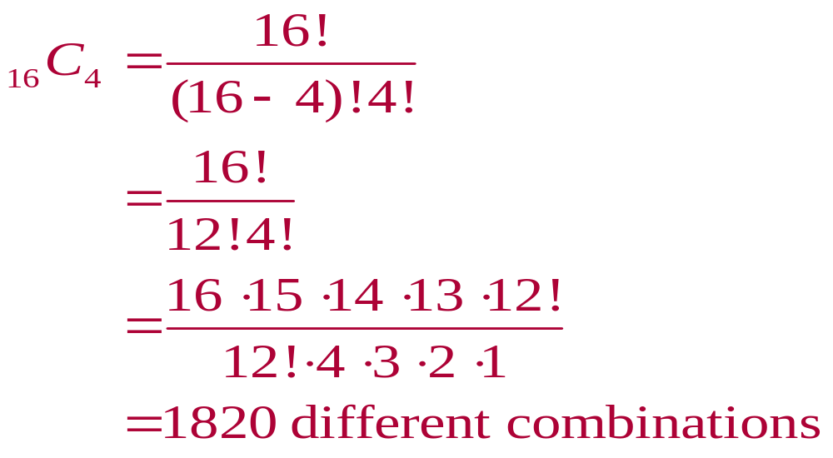
Solution: Combinations
© 2012 Pearson Education, Inc. All rights reserved.
<number> of 88

Slide 15

Example: Finding Probabilities
A student advisory board consists of 17 members. Three members serve as the board’s chair, secretary, and webmaster. Each member is equally likely to serve any of the positions. What is the probability of selecting at random the three members that hold each position?
© 2012 Pearson Education, Inc. All rights reserved.
<number> of 88

Slide 16
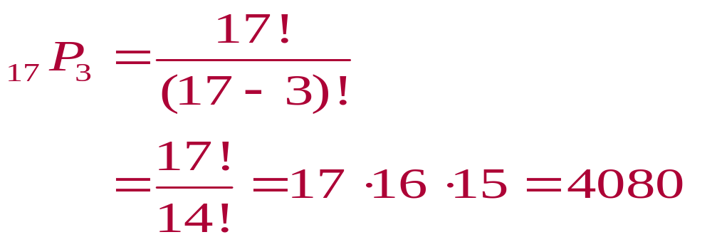
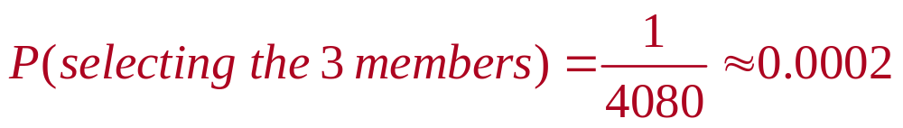
Solution: Finding Probabilities
There is only one favorable outcome
There are
  ways the three positions can be filled
© 2012 Pearson Education, Inc. All rights reserved.
<number> of 88

Slide 17

Example: Finding Probabilities
You have 11 letters consisting of one M, four I’s, four S’s, and two P’s. If the letters are randomly arranged in order, what is the probability that the arrangement spells the word Mississippi?
© 2012 Pearson Education, Inc. All rights reserved.
<number> of 88

Slide 18
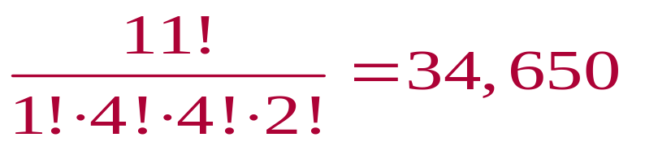

Solution: Finding Probabilities
There is only one favorable outcome
There are
  distinguishable permutations of the given letters
11 letters with 1,4,4, and 2 like letters
© 2012 Pearson Education, Inc. All rights reserved.
<number> of 88

Slide 19

Example: Finding Probabilities
A food manufacturer is analyzing a sample of 400 corn kernels for the presence of a toxin. In this sample, three kernels have dangerously high levels of the toxin. If four kernels are randomly selected from the sample, what is the probability that exactly one kernel contains a dangerously high level of the toxin?
© 2012 Pearson Education, Inc. All rights reserved.
<number> of 88

Slide 20
Solution: Finding Probabilities
The possible number of ways of choosing one toxic kernel out of three toxic kernels is
₃C₁ = 3
The possible number of ways of choosing three nontoxic kernels from 397 nontoxic kernels is
    ₃₉₇C₃ = 10,349,790
Using the Multiplication Rule, the number of ways of choosing one toxic kernel and three nontoxic kernels is
  ₃C₁ ∙ ₃₉₇C₃ = 3 ∙ 10,349,790 3 = 31,049,370
© 2012 Pearson Education, Inc. All rights reserved.
<number> of 88

Slide 21
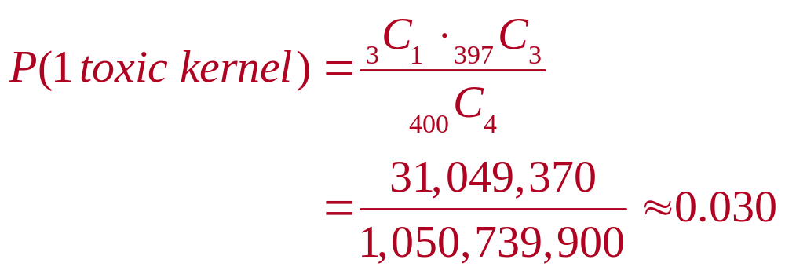
Solution: Finding Probabilities
The number of possible ways of choosing 4 kernels from 400 kernels is
₄₀₀C₄ = 1,050,739,900
The probability of selecting exactly 1 toxic kernel is
© 2012 Pearson Education, Inc. All rights reserved.
<number> of 88

Slide 22
Section 3.4 Summary
Determined the number of ways a group of objects can be arranged in order
Determined the number of ways to choose several objects from a group without regard to order
Used the counting principles to find probabilities
© 2012 Pearson Education, Inc. All rights reserved.
<number> of 88

